Slide 1
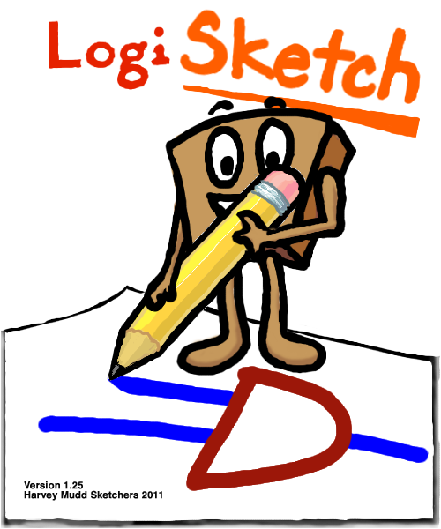
LogiSketch
Fiona Foo,
Andy Kearney,
Alexa Keizur,
Calvin Loncaric,
Miranda Parker,
Jessi Peck,
Kiley Sobel
An Intuitive System for Sketching and Simulating Logic Circuits
Advisor: Professor Christine Alvarado
Notes:
Introduce everyone and then present video

Slide 2
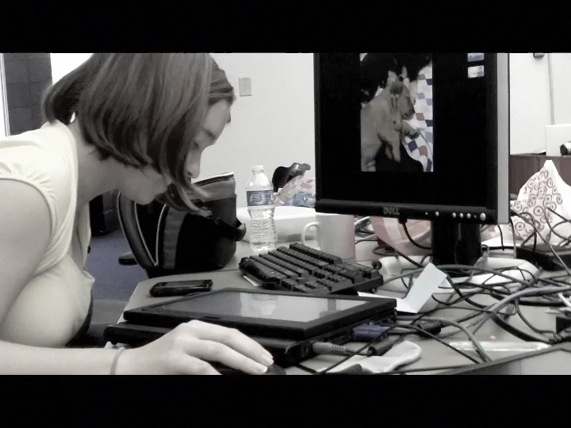
LogiSketch Video

Slide 3
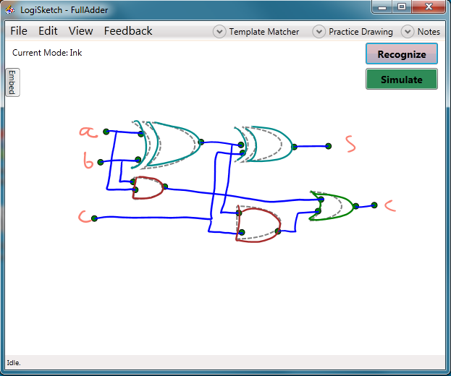
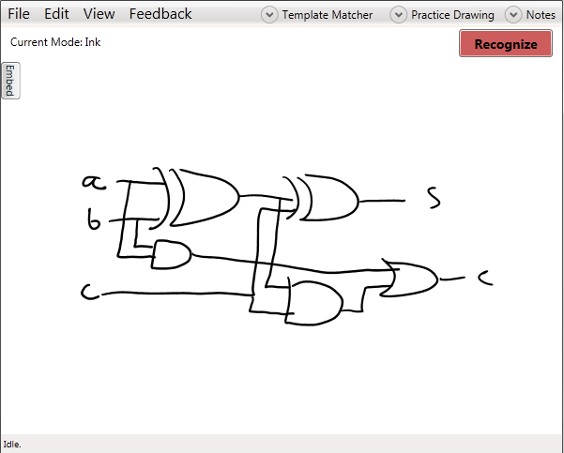
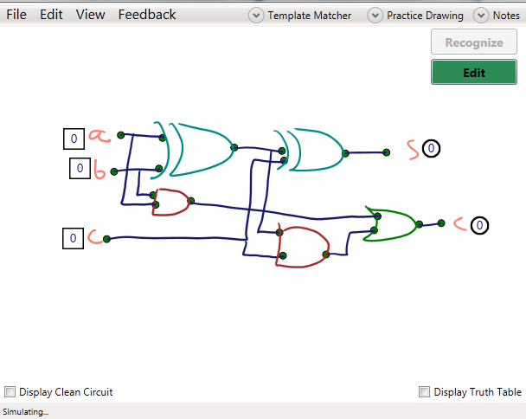
LogiSketch
An intuitive system for sketching, editing, recognizing, and simulating logic circuits in a tablet environment
Notes:
LogiSketch vs LogiSim
Use in CS5 and other classrooms, improve circuit-modeling experience
We will go over recognition, user interface design, and a user study we carried out this summer

Slide 4
Recognition
Transforming your sketches into reality

Slide 5
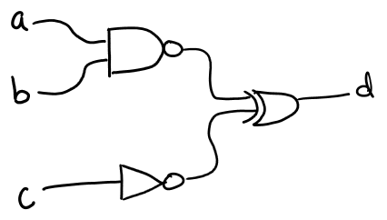
Recognition: Five Steps
Stroke Classification
Stroke Grouping
Shape Recognition
Shape Connection
Shape Refinement
Notes:
Mention that this was set up previously.

Slide 6
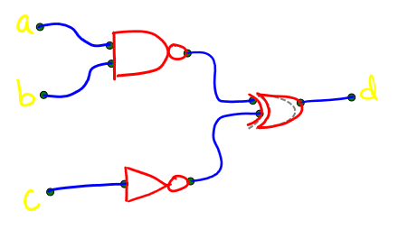
Recognition: Step One
Stroke Classification
Stroke Grouping
Shape Recognition
Shape Connection
Shape Refinement
Stroke: Stylus-down to Stylus-up
Wire, Label, or Gate?
Notes:
Mention that this was set up previously.

Slide 7
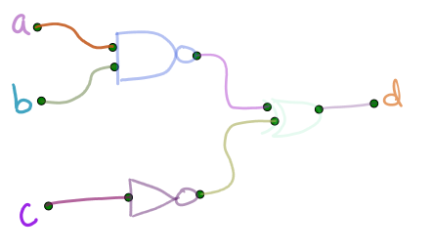
Recognition: Step Two
Stroke Classification
Stroke Grouping
Shape Recognition
Shape Connection
Shape Refinement
Groups individual strokes into shapes
Considers each pair of strokes for each classification
Notes:
Mention that this was set up previously.

Slide 8
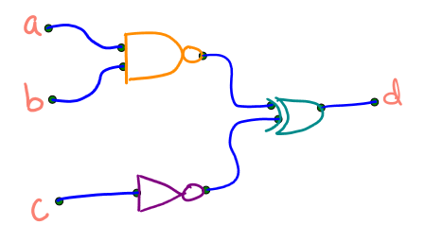
Recognition: Step Three
Stroke Classification
Stroke Grouping
Shape Recognition
Shape Connection
Shape Refinement
Three separate recognizers
Wire recognizer
Text recognizer
Gate recognizer
Notes:
Mention that this was set up previously.

Slide 9
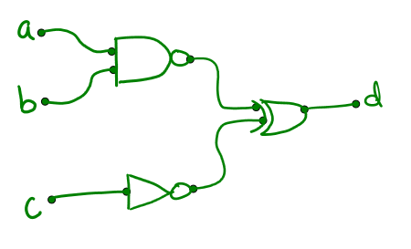
Recognition: Step Four
Stroke Classification
Stroke Grouping
Shape Recognition
Shape Connection
Shape Refinement
Connects recognized shapes into a circuit
Labels to wires
Gates to wires
Wires to wires
Notes:
Mention that this was set up previously.

Slide 10
Recognition: Step Five
Stroke Classification
Stroke Grouping
Shape Recognition
Shape Connection
Shape Refinement
Attempts to fix mistakes from other steps
Re-identify shapes
Form/break connections
Steal/shed strokes
?
Notes:
Mention that this was set up previously.

Slide 11
Shape Recognition: Old Model
Dollar Recognizer
Bayes Net
?
Image Recognizer
Combination Recognizer
XNOR
Zernike Recognizer
Rubine Recognizer

Slide 12
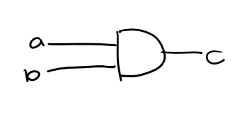



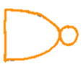
Image Recognition
To improve recognition accuracy, we created an image-based recognizer to classify logic gates.
And?
Not Bubble?
Nand?
Or?
Notes:
We created AIR. Matches your drawing against templates to attempt to assign the correct gate-label to your shape.

Slide 13
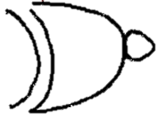

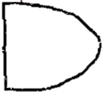
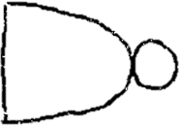
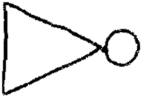

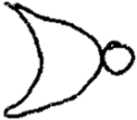
Our Image Recognizer
Nearest neighbor classifier
4 image matching algorithms
Tanimoto Coefficient
Hausdorff Distance
Modified Hausdorff
Yule Coefficient
Templates are idealized drawings
5 templates per gate

Slide 14
Image recognizer is already a major improvement
Can we make it even better?

Slide 15
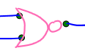
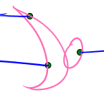
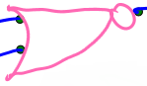
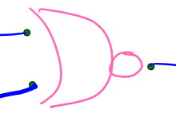
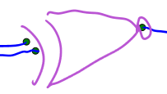
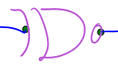
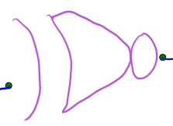
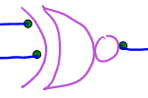
Actual Drawings from Actual Users

Slide 16
Adaptive Recognizer
Users have distinct drawing styles
How can we make the recognizer adapt to the user?

Slide 17
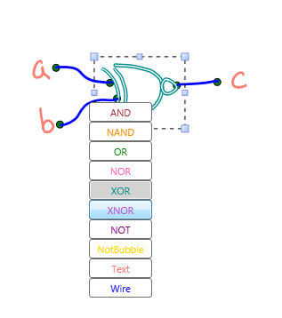
Adaptive Image Recognizer
Notes:
When the system incorrectly recognizes a gate, the user can correct that error. The AIR will then adapt to the error correction and will hopefully never make the same mistake again!
Users have distinct drawing styles, and the general recognizer tries to recognize everything. However, if just one user is working with the system on a particular computer, we can adapt the recognition to their particular drawing style.
When a user corrects an error, we add the template to the image recognizer, so the next time it sees a similar looking gate, it will recognize it correctly.
We know when the program made a mistake because the user will correct the error in their circuit.
We want to teach the recognizer to not make the same mistakes repeatedly.
So when the user corrects an error, add that template to the database that we compare against.

Slide 18
User Adaptation Improves Recognition
Notes:
Initial tests show that the recognizer quickly gets significantly better when learning from its mistakes
Describe graph and axes in detail
Give more detail about what the testing procedure was

Slide 19
Template “Phase-Out”
Problem
Too many templates slows system down
Bad templates can get added
Solution!
Limit the number of templates per gate
Remove unhelpful templates
Notes:
BETTER PICTURE – maybe pics of our templates?
Maintain efficiency
Improve accuracy
Eliminate bad templates
We also “phase-out” templates that caused past incorrect recognitions. Limiting the number of templates helps us maintain the efficiency of the software.
Keep track of the “usefulness” of each template to see which ones to remove.
Say you’re feeling lazy one day and you draw a couple of sloppy gates. These may get introduced as templates if you relabel them. But these may lead to recognition errors, so you don’t want them to stick around forever. So we get rid of the ones that lead to unhelpful results.

Slide 20
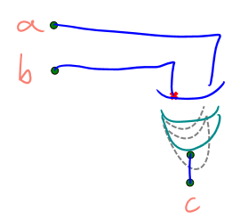
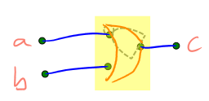
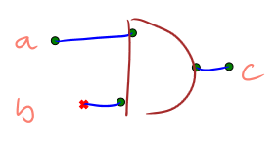
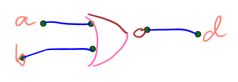
Nobody’s (Recognizer is) Perfect
Classification
Problems
Recognition Problems
Grouping Problems
Connection Problems

Slide 21
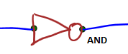
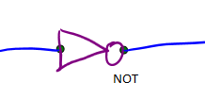


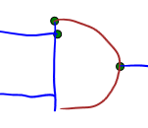
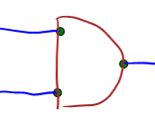
Shape Refinement
Re-identify shapes
Form/break connections
Steal/shed strokes

Slide 22
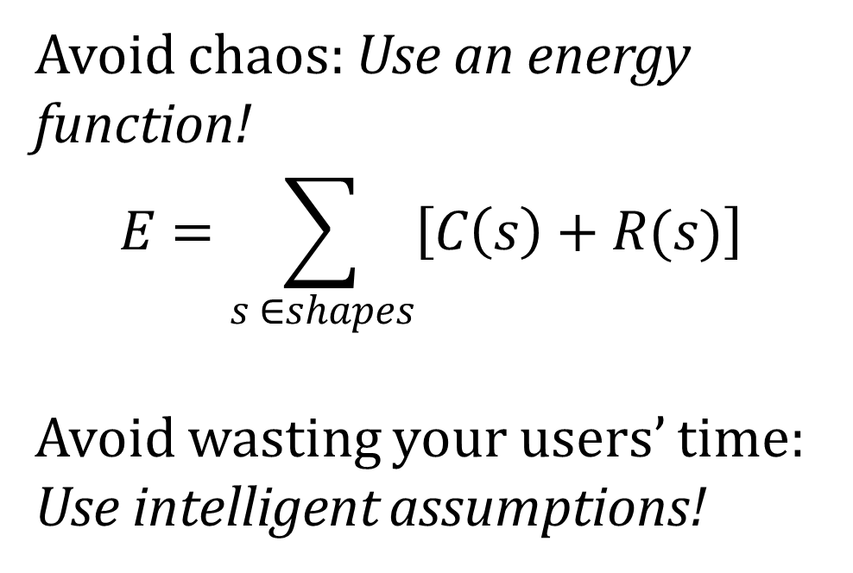
Avoid chaos: Use an energy function!
$$E=\sum_{s ∈shapes}{\left[C\left(s\right)+R(s)\right] }$$
Avoid wasting your users’ time: Use intelligent assumptions!

Slide 23
Results
Classification Quality
Grouping Quality
Recognition Quality
Per-Substroke

Slide 24
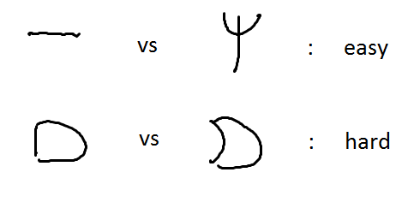
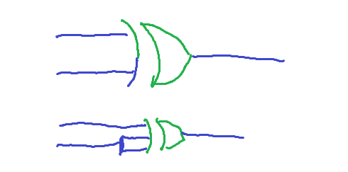
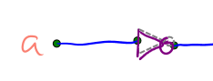
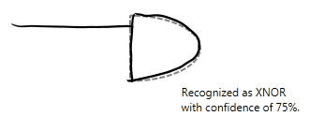
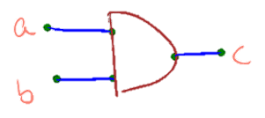
Limitations
90%
91.346%
?

Slide 25
Similarities between gates
90%
91.346%
?

Slide 26
Obviously incorrect recognitions often have a correct interpretation
90%
91.346%
?

Slide 27
Different specialized recognizers give incomparable measurements
90%
91.346%
90%
91.346%
?

Slide 28
Confidences are unreasonably high on previously unseen shapes
90%
91.346%
?

Slide 29
Identical Contexts
90%
91.346%
?
?

Slide 30
User Interface
Improving the user experience

Slide 31
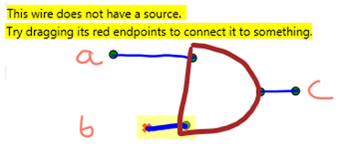
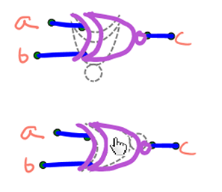
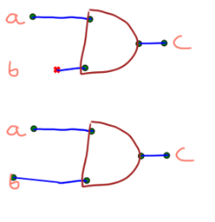
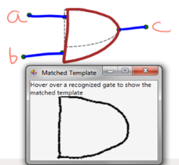
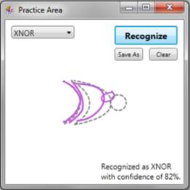
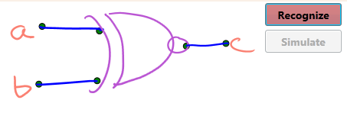
Initial User Study
What problems are users having?
Communicating errors with the user
Exposing the recognizer
How can we fix them?
Notes:
Going to talk about – Problem that motivated our research
Solutions to expose the issues
Intuitive ways to correct the problem
Exposing the recognizer

Slide 32
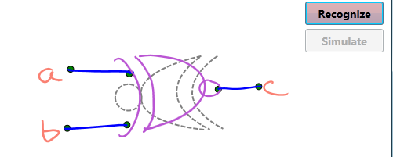
Why won’t this simulate?
Ghost Gates show why

Slide 33
Orientation was a problem. We now let you manually set the orientation.

Slide 34
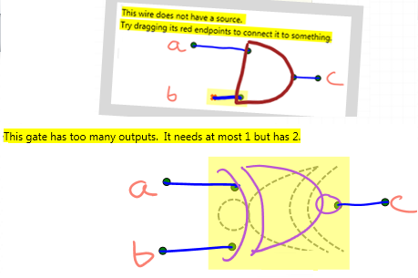
Parsing errors were hidden from the user. All parsing errors now are highlighted with descriptions

Slide 35
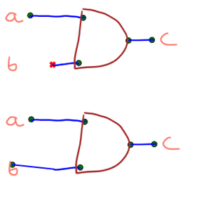
Connections were a problem. We now let you manually extend wires, creating connections permanently

Slide 36

The recognizer’s behavior was hidden from the user. Now the templates matched to the strokes are viewable.

Slide 37
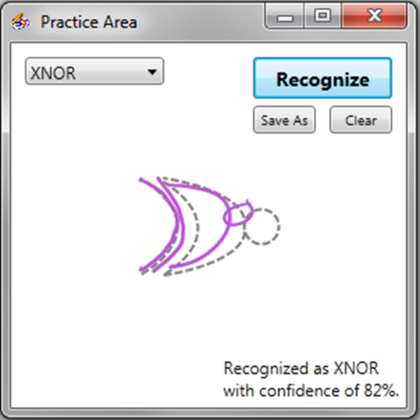
Users had no way of trying to explicitly interacting with the recognizer. Now the user can practice gates.

Slide 38


Creating complex circuits
Notes:
Allow users to create more complex circuits
Compatible with LogiSim

Slide 39

Notes:
Allow users to create more complex circuits
Compatible with LogiSim

Slide 40

Notes:
Allow users to create more complex circuits
Compatible with LogiSim

Slide 41

Compatibility with other tools
Notes:
Allow users to create more complex circuits
Compatible with LogiSim

Slide 42
Future Work
Investigate user responses to moving and rotating UIs
Develop more precise tools for correcting grouping vs. recognition errors

Slide 43
User Study
Exploring drawing style adaption
Notes:
-Link into past slides

Slide 44

Background
There is a relationship between how sketches are drawn and how much work recognition has to do.
Could the system sway users to inadvertently draw in a certain way so recognition wouldn’t have to work as hard?
No, no! A NOR looks like this!
Notes:
Draw closer to the recognizers ideals
If the user adapts, the recognizers don’t have to be as good
Trade off between programmer time and the time it takes the system to run vs. the improvement of the users’ drawing style (less of the user’s and system’s time

Slide 45
Research Question & Hypothesis
Will users adapt their drawing styles to improve recognition when given certain feedback from the system?
Hypothesis: Users drawing with specific feedback that tells them how their drawing can improve will make more positive drawing style changes, compared to users drawing without that feedback.

Slide 46


Procedure
NAND
Condition 1: Ghost Gates
Condition 2: No Ghost Gates
12 users total
Each user draws and corrects 14 circuits
Notes:
Alexa talked about differences in feedback:
In both cases, they get recognition feedback (told what everything is).
For the ghost gate condition, they also received drawing feedback, what they could do to make their drawing better.
We never explicitly told the users how they should draw (see if they would make this change on their own, implicitly)

Slide 47

Gate Drawings Over Time
Condition 1: Ghost Gates
Notes:
Here are a couple of examples of users’ sketches of gates over time. Notice here the back of gates get curvier.

Slide 48

Gate Drawings Over Time
Condition 2: No Ghost Gates

Slide 49
Results
Measurement: correct recognition rate (the percent of the total gates that were recognized correctly by the system) for each sketch.
Notes:
For both cases, users did not change their drawing style over time. Insignificant results. There was no correlation between time (trial and recognition rate)- which indicates that users resist changing their drawing style

Slide 50
Why were our results insignificant?
Long study, got lazy
Thought the recognition wasn’t improving when they tried to improve their drawings
Orientation and proportions of gates
Never explicitly told users that the ghost gates mirrored what recognizers want
Mudders (or people in general…) are stubborn!

Slide 51
Good News .
One significant result from the interview!
Real user quotes:
“This is so much better than LogiSim.”
“I appreciate that much more than LogiSim.”
“This is kind of fun.”
Notes:
We did get significant results in that ghost gate users thought the feedback from the system was more helpful (showed recognition errors better) than the non-ghost gate users (text is bad)

Slide 52
Future Work
Carry out more user studies under different conditions (e.g. use the practice window)
Use the adaptive image recognizer
Change how ghost gates scale but still reflect recognition

Slide 53

Acknowledgements
We’d like to thank our research advisor, Professor Christine Alvarado, all the students who have worked on this project in the past, and the students who participated in the user studies.
This work is supported in part by an NSF CAREER award (IIS-0546809).

